Slide 1
Welcome
PowerPoint Presentation
ON
Unit-1, Lesson-2
The Unforgettable History
Prepared by
Md. Tarikul Ghani

Slide 2
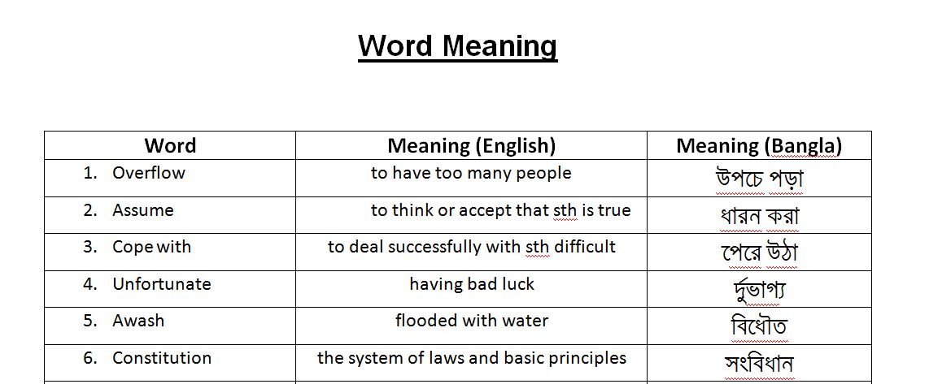

Slide 3
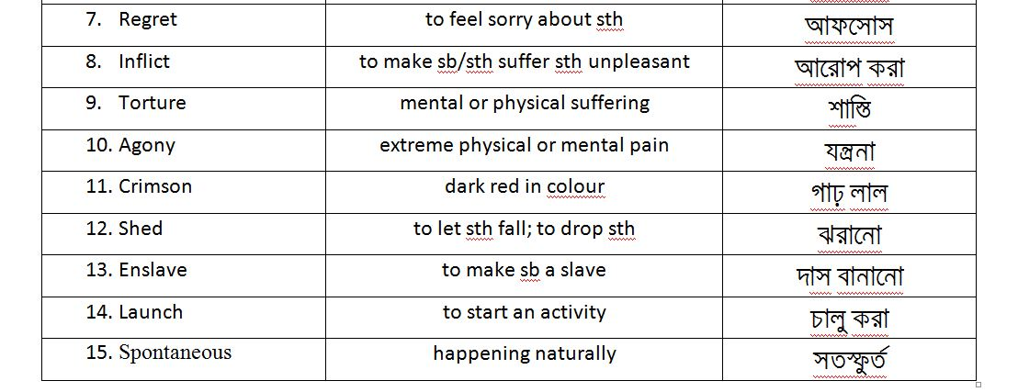

Slide 4
Multiple Choice Question
Choose the word which is closest in meaning in the context:
(i) What does the word awash refer to?
a) oppression b) wash c) flooded d) bloody
(ii) The word Spontaneous means-
a) continuous b) natural c) struggle d) trick
(iii) The word enslave means-
a) oppression b) existence c) enchain d) liberation

Slide 5
(iv) What does the word Slaughter mean?
a) hurt b) massacre c) repression d) gather
(v) The word overflow refers to-
a) severe b) out cast c) disturb d) outburst

Slide 6
Write down answer to the following questions
a) What was the purpose Sheikh Mujib’s struggle?
b) Why did the people of Bangladesh give vote for Sheikh Mujibur Rahman?
c) How was the twenty three years of Bangladesh under Pakistan?
d) What was the urge of Mujib after the general election in 1970?
e) What did Yahya Khan do after the election in 1970?
f) What did Bhutto say when Sheikh Mujib said to create a constitution for Pakistan?

Slide 7
g) What happened after the Assembly’s session was prorogued?
h) What did Mujib ask Yahya khan to observe?
i) Which conditions were give by Mujib to join assembly on 25 March?
j) Why did not he join round table conference?
k) What did he request all the people of Bengal?
l) How do you differentiate between the ‘struggle for freedom’ and the ‘struggle for emancipation?’

Slide 8
Thank You

